Slide 1


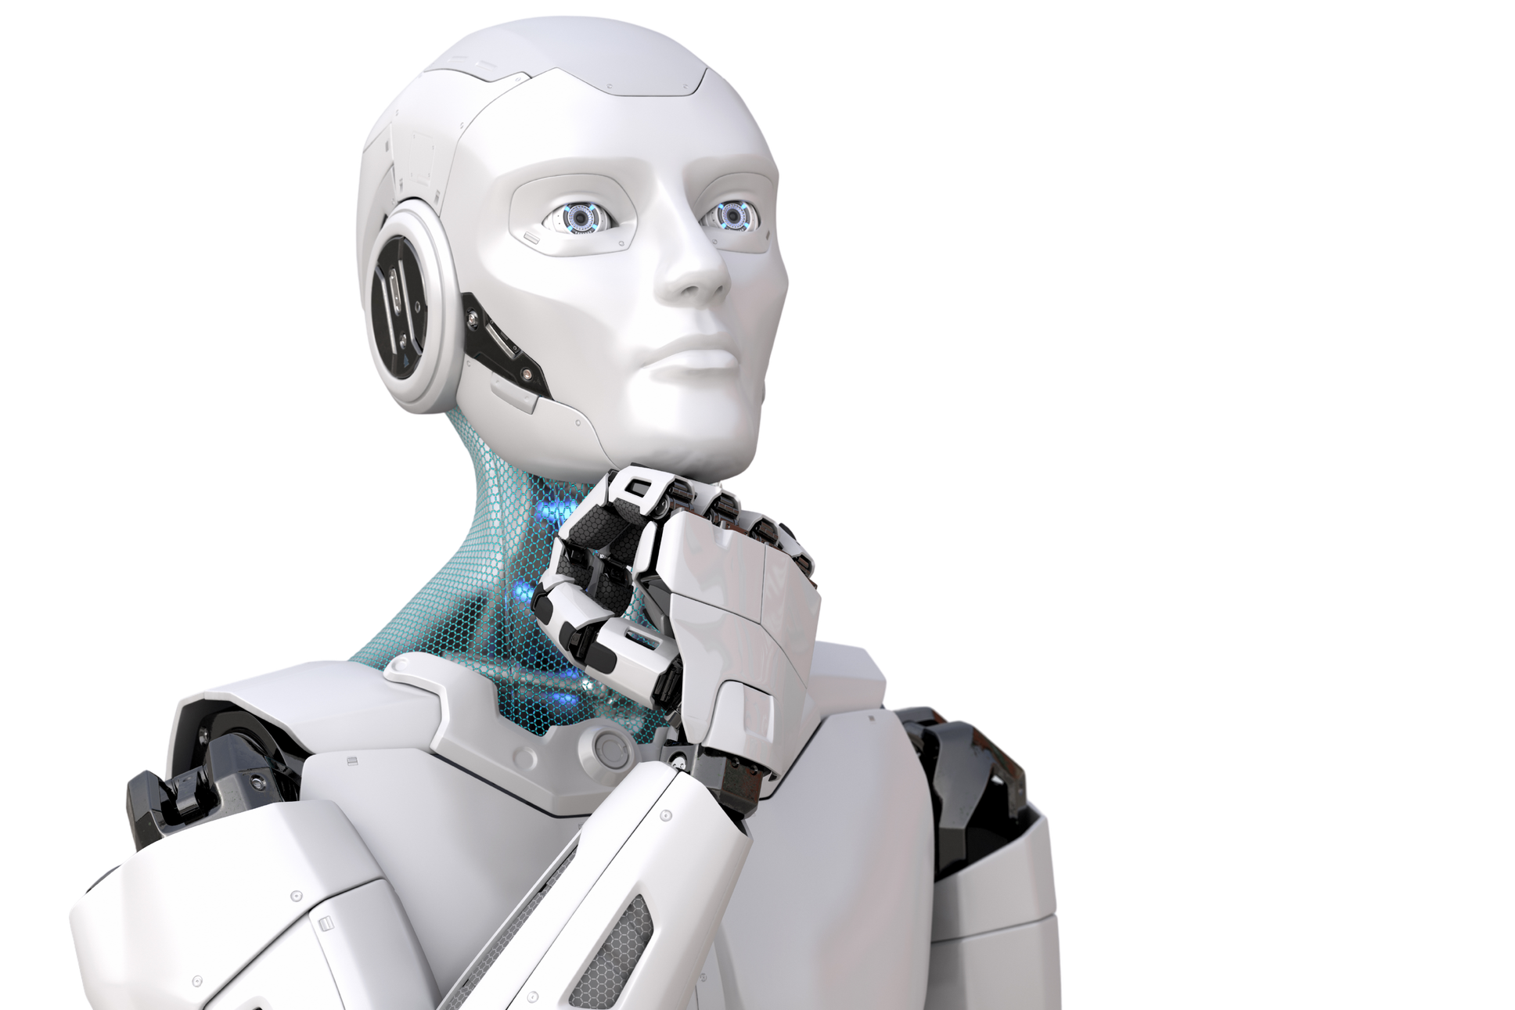


AI
ARIANA
Your Friendly Chatbot Helper — Ask Anything,
Get Answers Fast! 🚀
Presented by
ARIANNE MAE APOSTOL
Notes:
Good [morning/afternoon] everyone! My name is Arianne Mae Apostol, and today I'm excited to introduce you to Arianna AI — your friendly chatbot helper. Ask anything, get answers fast.

Slide 2
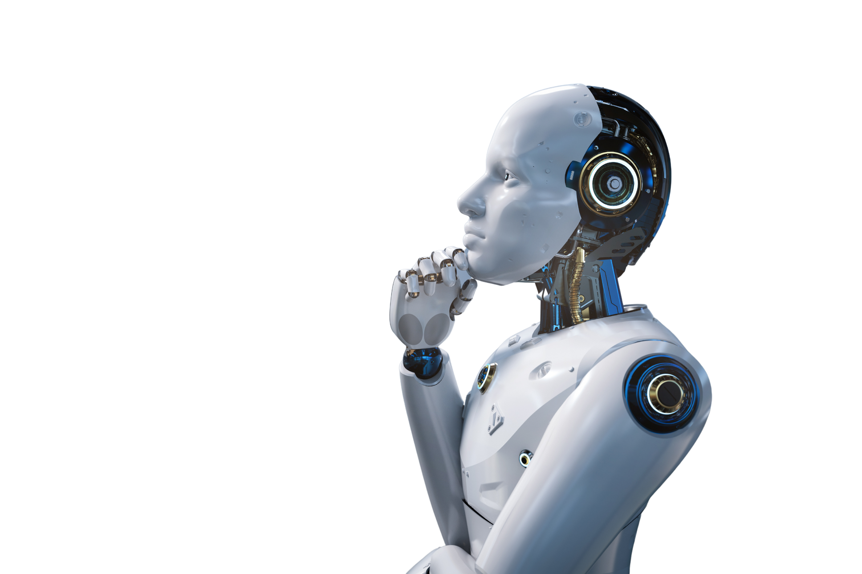
WHAT IS ARIANNA AI?

Slide 3
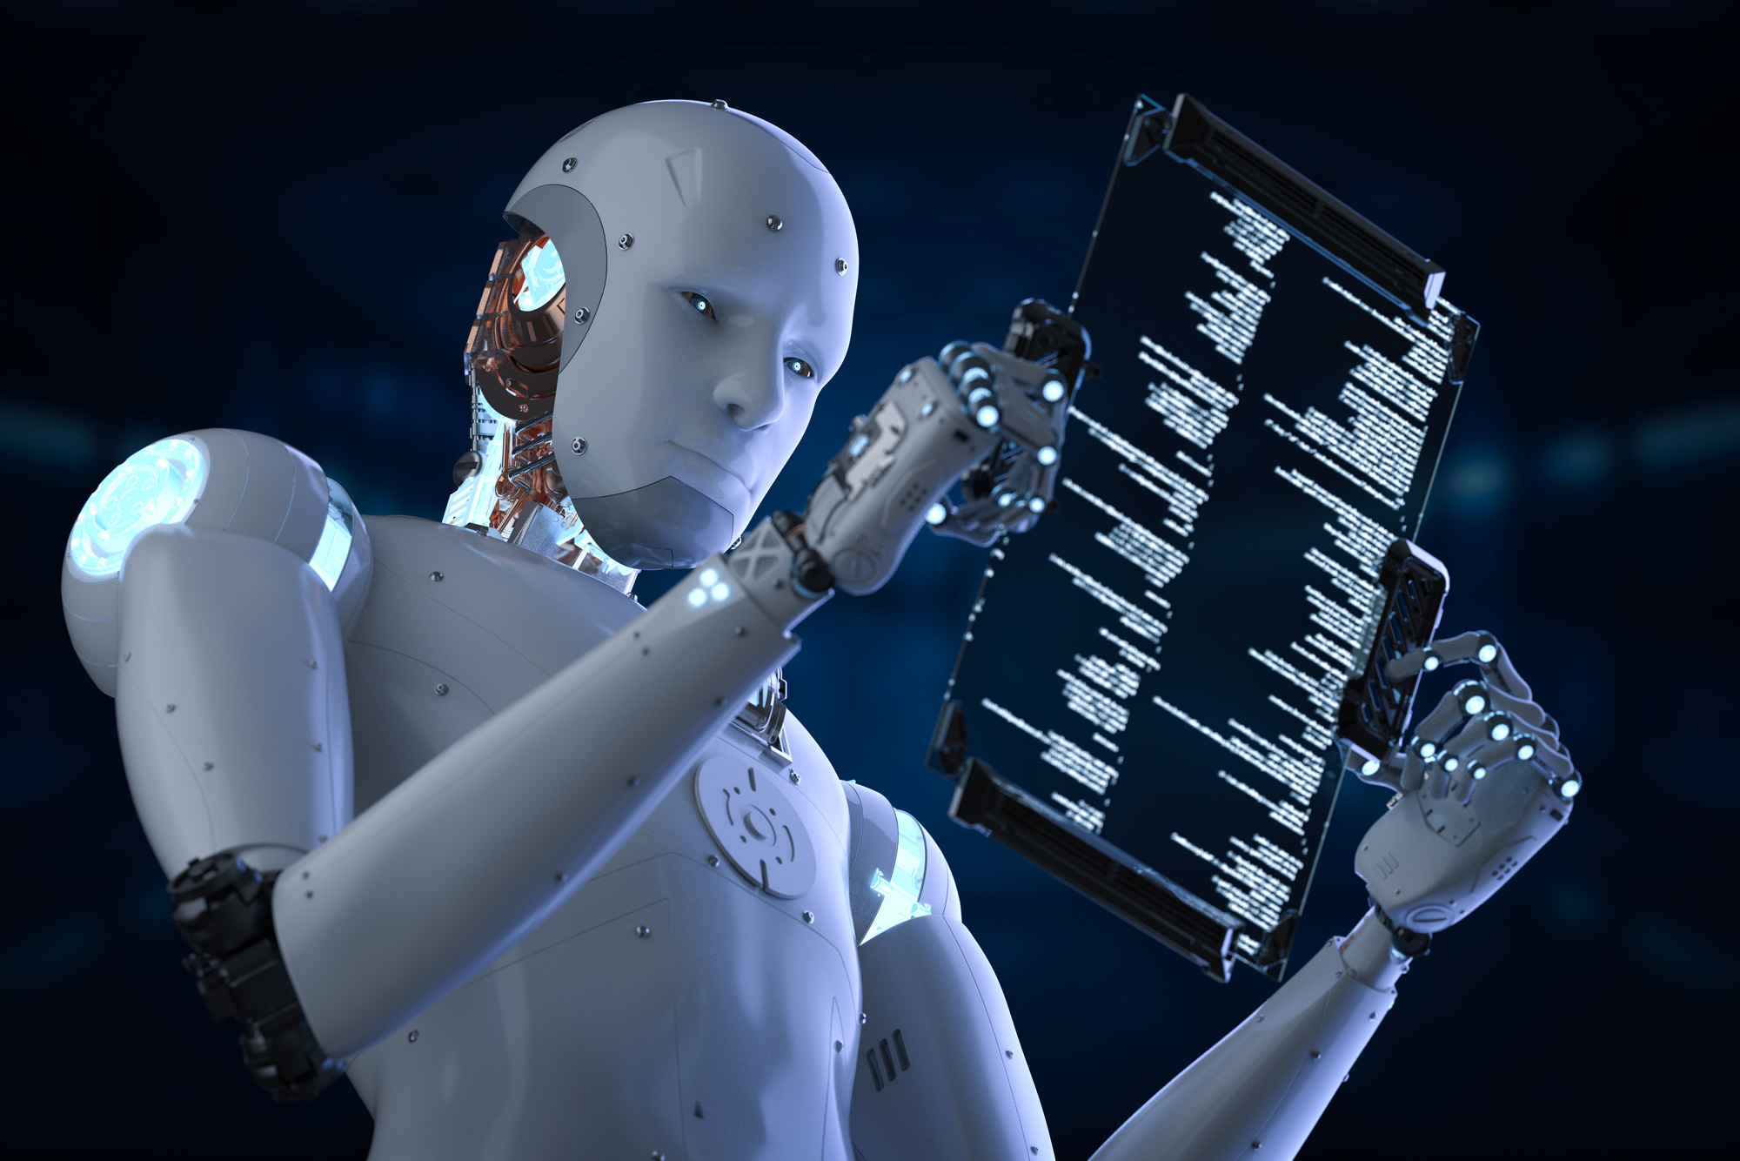
MEET ARIANNA!
Arianna AI is a smart chatbot like a super-helpful friend you can chat with on a computer anytime you need help!

Slide 4

YOU TALK, SHE LISTENS
Just type your question like sending a text message, and Arianna replies right away!

Slide 5

POWERED BY A SMART BRAIN
Arianna uses Google Gemini one of the smartest AI brains in the world to think and answer you.

Slide 6

THE PROBLEM WE'RE SOLVING

Slide 7

GETTING HELP CAN BE HARD!
Imagine you need help with homework or a question, but your teacher is busy, and searching Google gives you 1,000 complicated pages. That's annoying! 😤
Sometimes you just want a simple, friendly answer not a textbook!

Slide 8

COMMON STRUGGLES
  Too Complicated: Search engines show confusing results with big fancy words.
  No One to Ask: Sometimes there's nobody around to help you right now.
  Hard AI Tools: Other AI tools are confusing and require lots of setup.

Slide 9


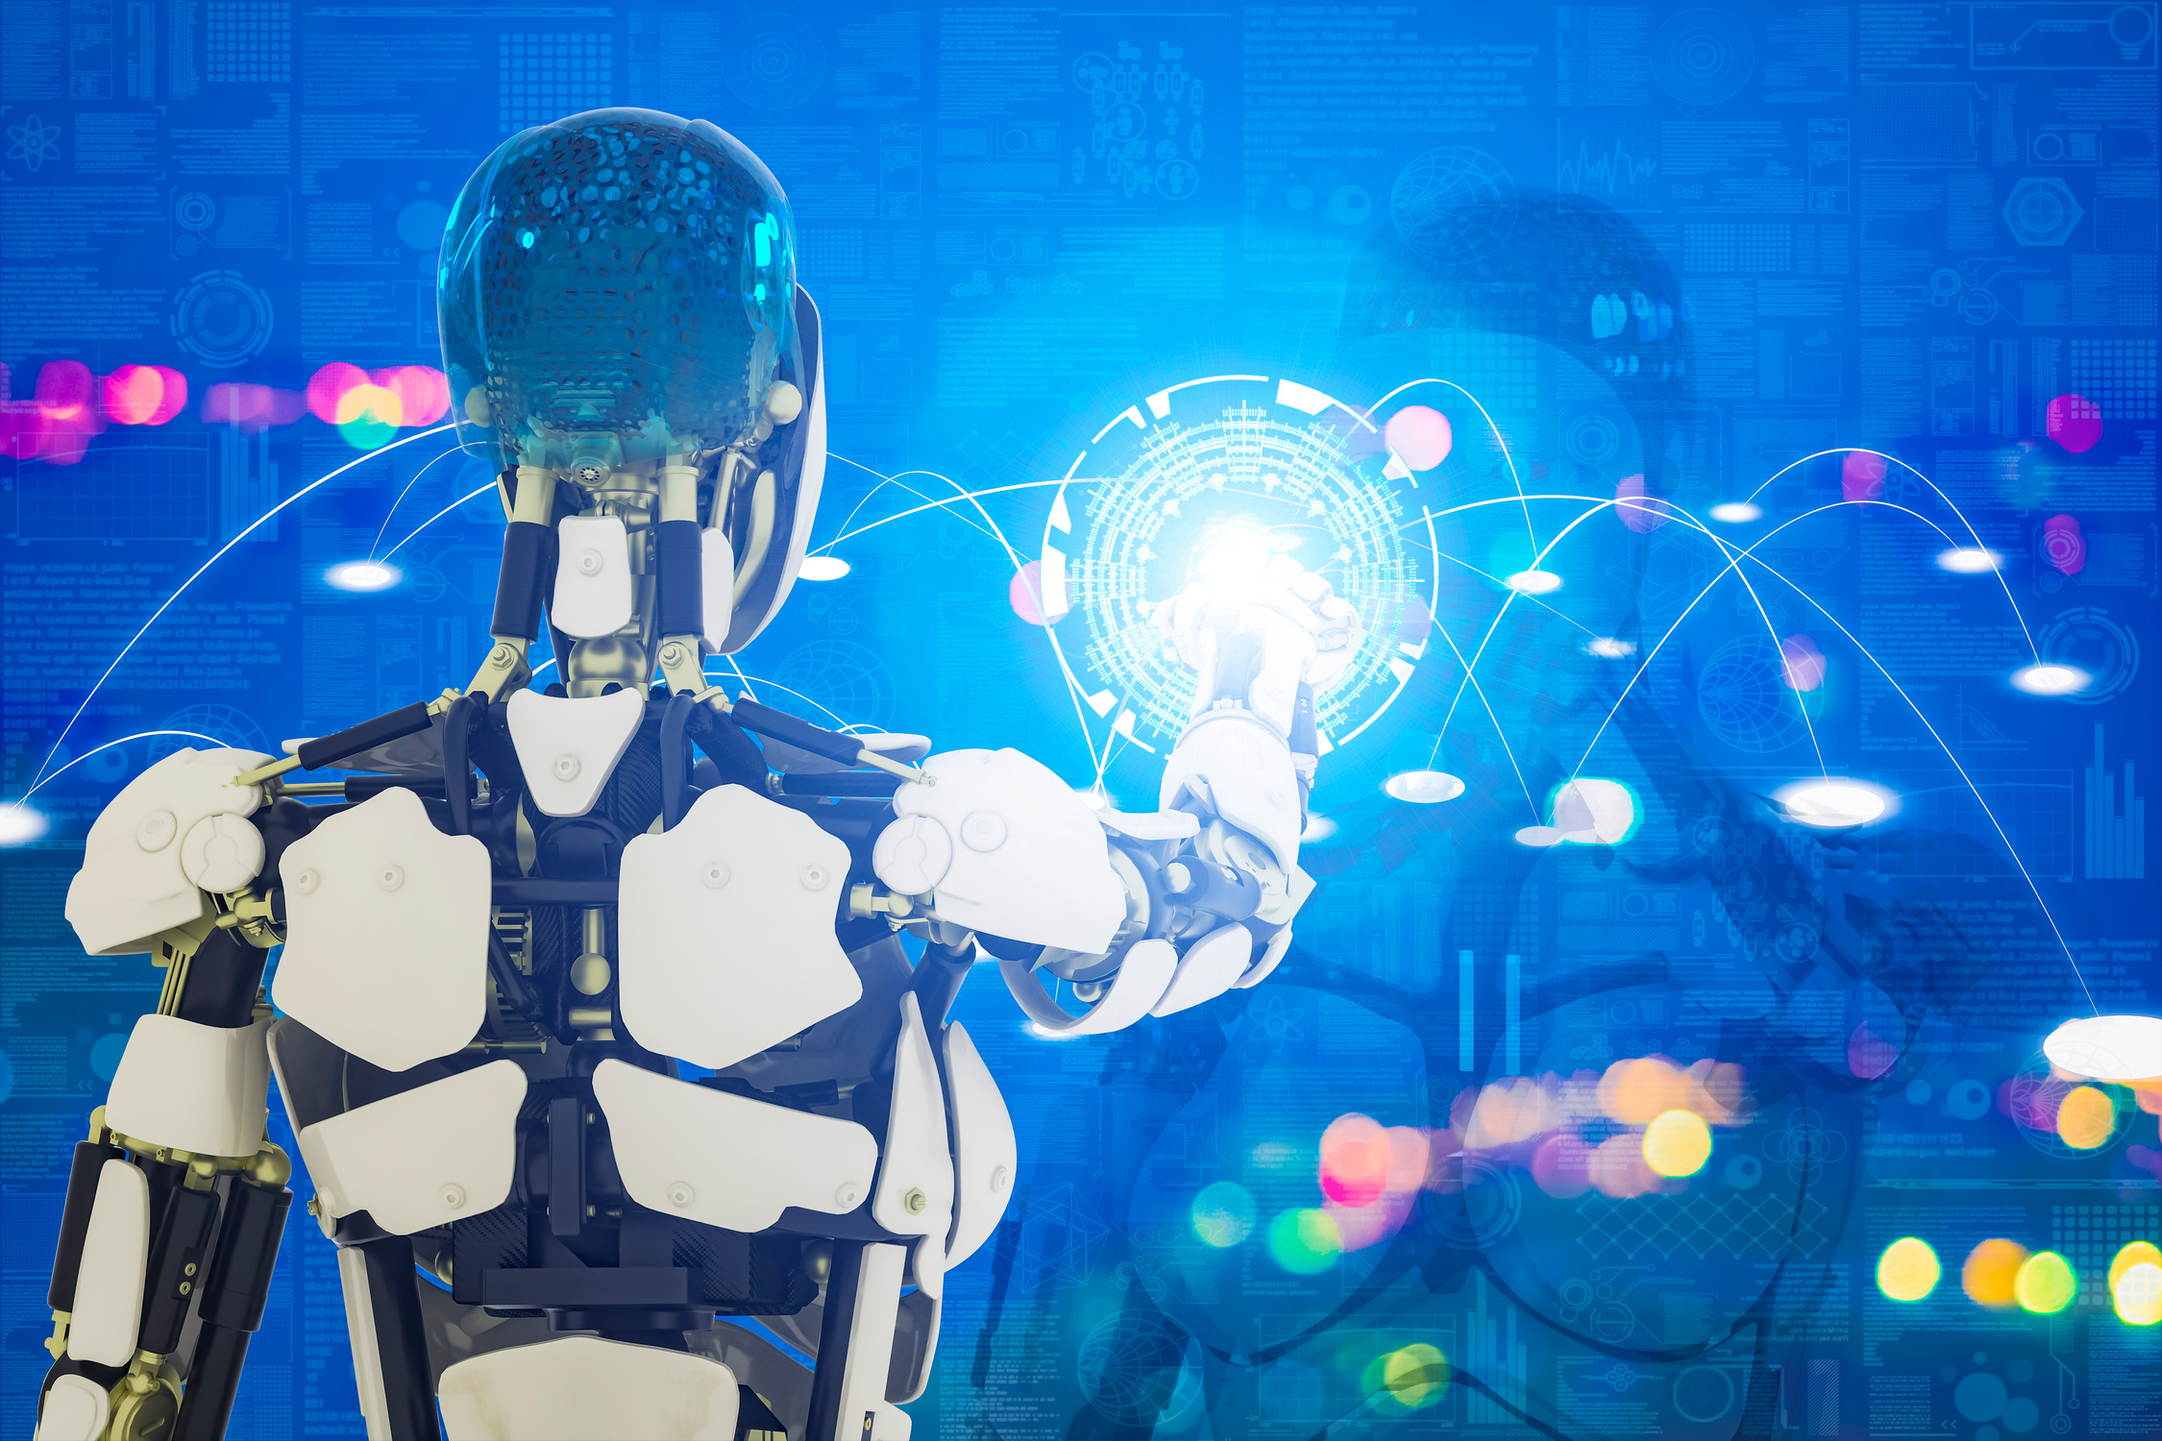

ARIANNA AI
IS THE
ANSWER!
JUST TYPE & ASK
Type any question in plain English, just like texting a friend. Arianna understands you!
GET FAST ANSWERS
Arianna replies in seconds no waiting, no searching, no confusing links!
YOUR CHATS STAY PRIVATE
All your conversations are saved only on YOUR computer. Nobody else can read them!

Slide 10


HOW DOES ARIANNA WORK?
It's as easy as 1 — 2 — 3! 😊
01
YOU TYPE
02
03
APP SENDS IT
ARIANNA ANSWERS
You type a question in the chat box, like asking your friend.
The app secretly passes your question to a super smart computer in the cloud.
Arianna types her answer back to you, word by word, right on screen!
SENT
REPLY

Slide 11
WHAT CAN ARIANNA HELP WITH?
HOMEWORK HELP 📚
CODING HINTS 💻
Ask Arianna to explain math, history, science, or any subject you're stuck on!
Learning to code? Arianna can help you fix bugs or explain how code works!
WRITING HELP ✍️
TRANSLATION 🌍
Need to write a story or an email? Arianna can help you put your ideas into words!
Need something in another language? Arianna can translate text for you!
ANSWER QUESTIONS 💡
JUST CHAT! 😊
Curious about something? Ask Arianna! She can explain almost anything in simple words.
Want to just talk and share ideas? Arianna is always here to listen and chat!

Slide 12
SEE ARIANNA IN ACTION!
A Real Conversation Example 💬
Look how easy it is! You just type your question, and Arianna replies like a real conversation.
You
What is AI?
WHY ARIANNA IS AWESOME
Arianna
AI (Artificial Intelligence) refers to computer systems designed to perform tasks that typically require human intelligence — things like understanding language, recognizing images, making decisions, solving problems, and learning from experience.
  Gives simple answers — no big confusing words.
  Replies instantly — no waiting like Google search.
  Feels like talking to a real friend who knows a lot.
  You can ask follow-up questions and she remembers the conversation!
You
Thank you for a very informative response.
Arianna
You're welcome! Glad it was helpful.

Slide 13
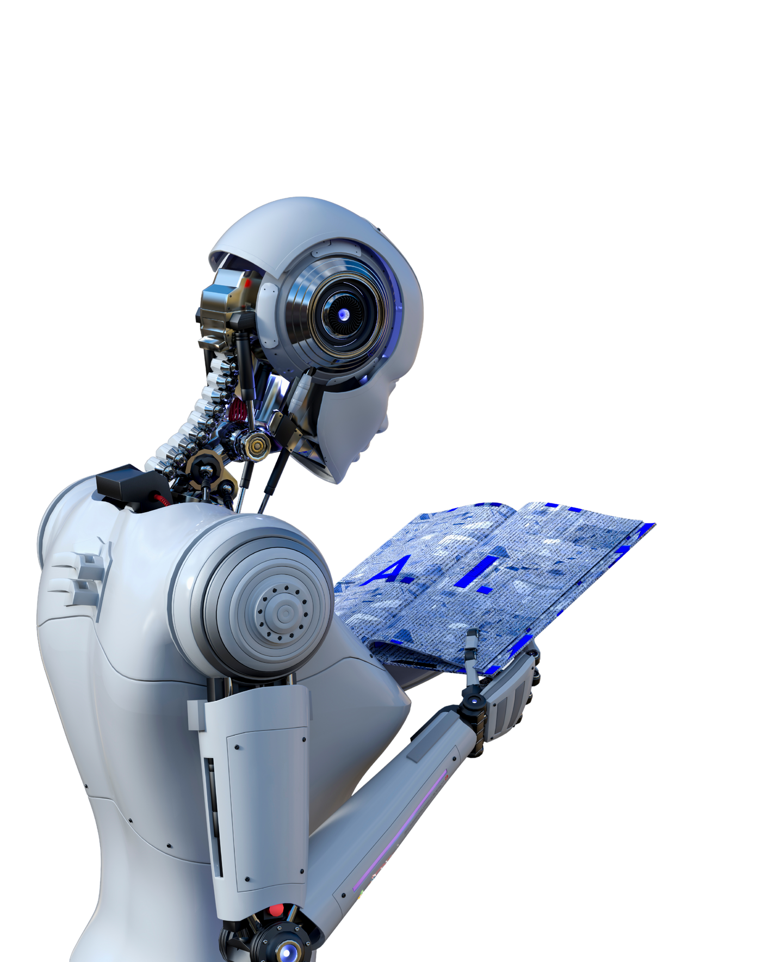
THE TECH BEHIND ARIANNA

Slide 14

THE WEBSITE (FRONTEND)
The chat screen you see and click on. Built with HTML, CSS, and JavaScript — the same language that makes websites look pretty!

Slide 15

THE ENGINE (BACKEND)
A hidden helper running on your computer using Python and FastAPI. It takes your message and passes it to the smart brain.

Slide 16

THE BRAIN (GEMINI AI)
Google's Gemini AI is the super-smart engine that thinks and creates the answer. It's like the world's biggest library + the smartest librarian!

Slide 17
WHO IS ARIANNA AI FOR?

Slide 18

STUDENTS
Get homework help, essay writing tips, and explanations in simple language no more hours of searching Google!

Slide 19
TEACHERS
Create lesson plans, quiz questions, or get help drafting parent letters Arianna helps teachers save time too!

Slide 20

SMALL BUSINESS OWNERS
Need to write product descriptions or plan your business? Arianna helps small shop owners with everyday tasks!

Slide 21
LET'S BUILD ARIANNA TOGETHER! 🚀
"A super friendly chatbot that answers your questions simply, privately, and instantly — powered by Google Gemini!"

